Slide 1

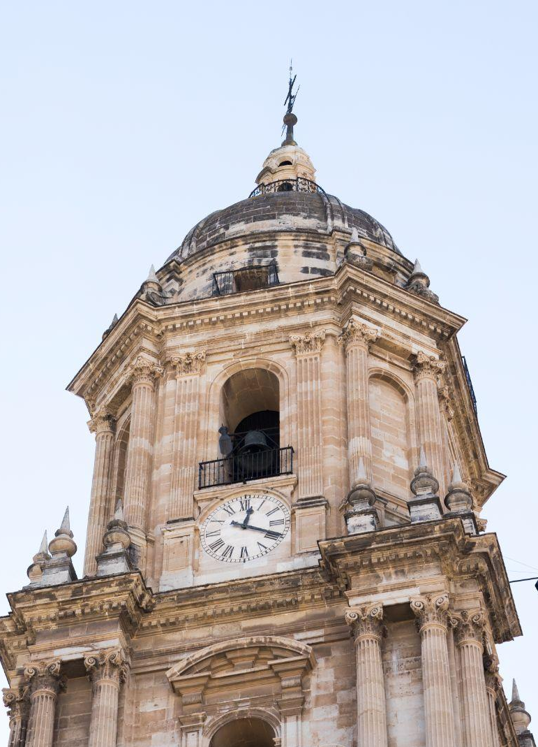

The Aga Khan Palace An Uplifting Visit
Presentation in Indian Tradition Cultural & Heritage

Slide 2
Our Group Members
Krishnaraj Thadesar
Parth Zarekar
Sourab Karad
Took Photos and contributed in Filming Our Videos. 1032210888 PA 10
Researched the applications
that allowed us to GeoTag our photos.
1032210846
PA07
Arranged Travel for all members of the group.
1032211150
PA25
Maitreyee Jadhav
Saubhagya Singh
Suggested the place despite it being far away from us.
1032211369
PA29
Guided us throughout the visit of the Palace owing to his previous visits.
1032211144
PA24

Slide 3
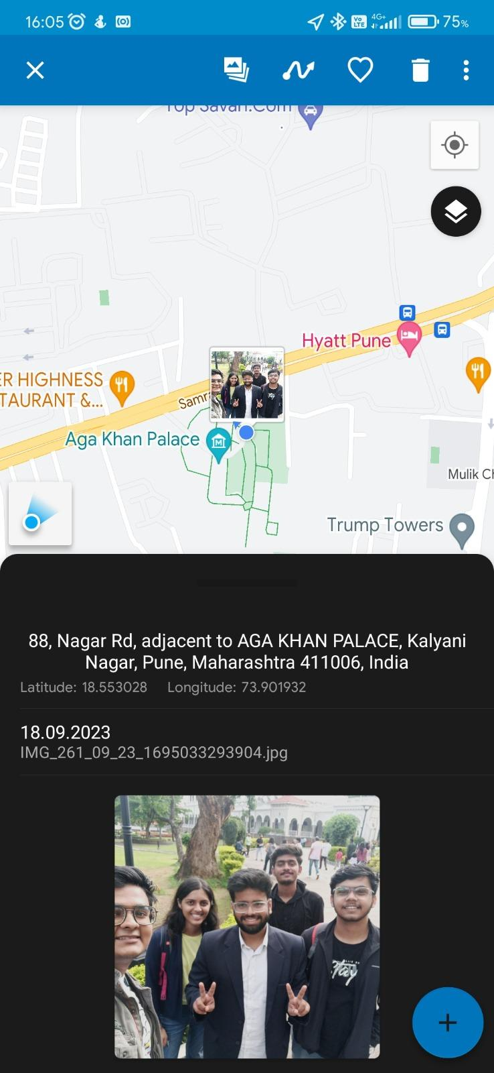
Our Geo Tagged Image of the visit.

Slide 4
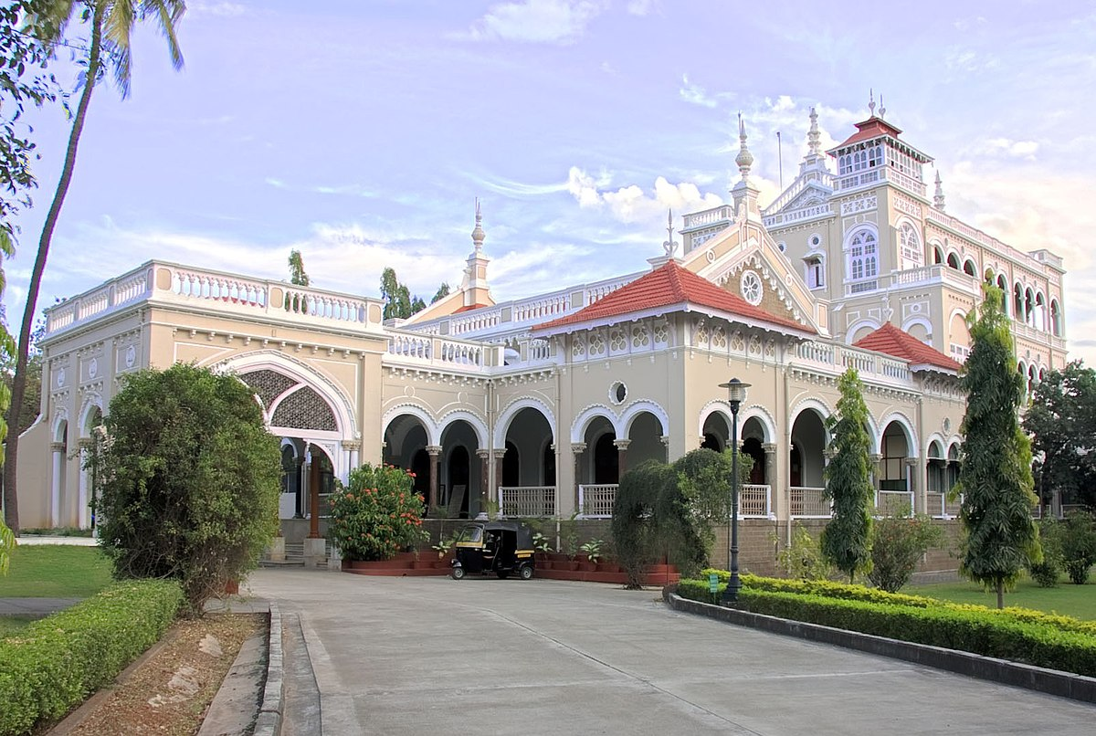
The Aga Khan Palace

Slide 5
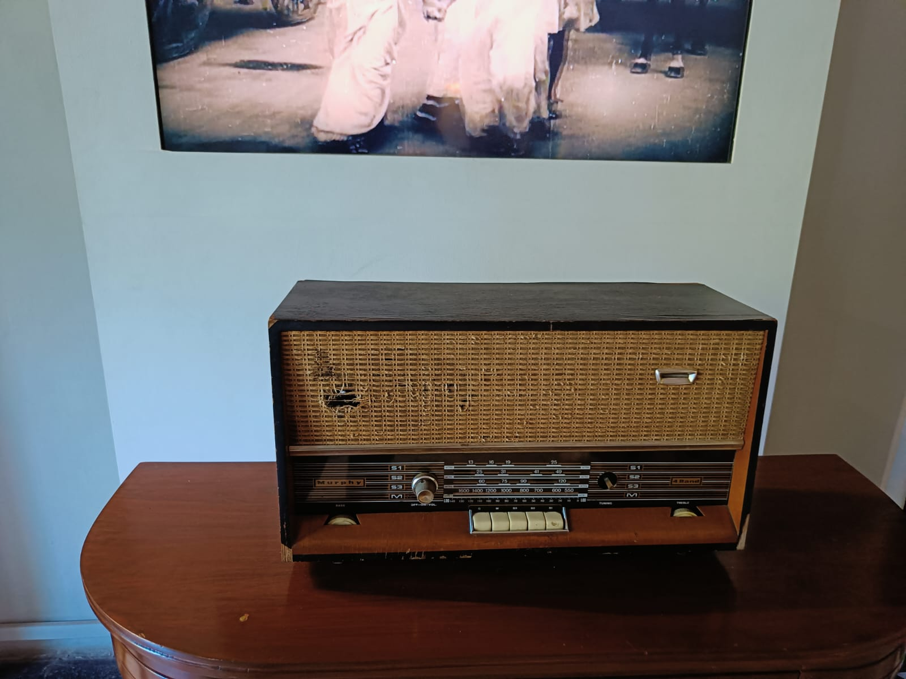
The Radio of Shri. Mahatma Gandhi

Slide 6
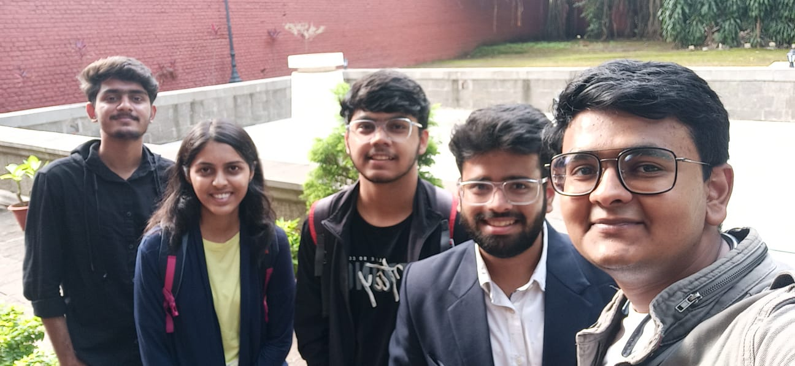
Our Group

Slide 7
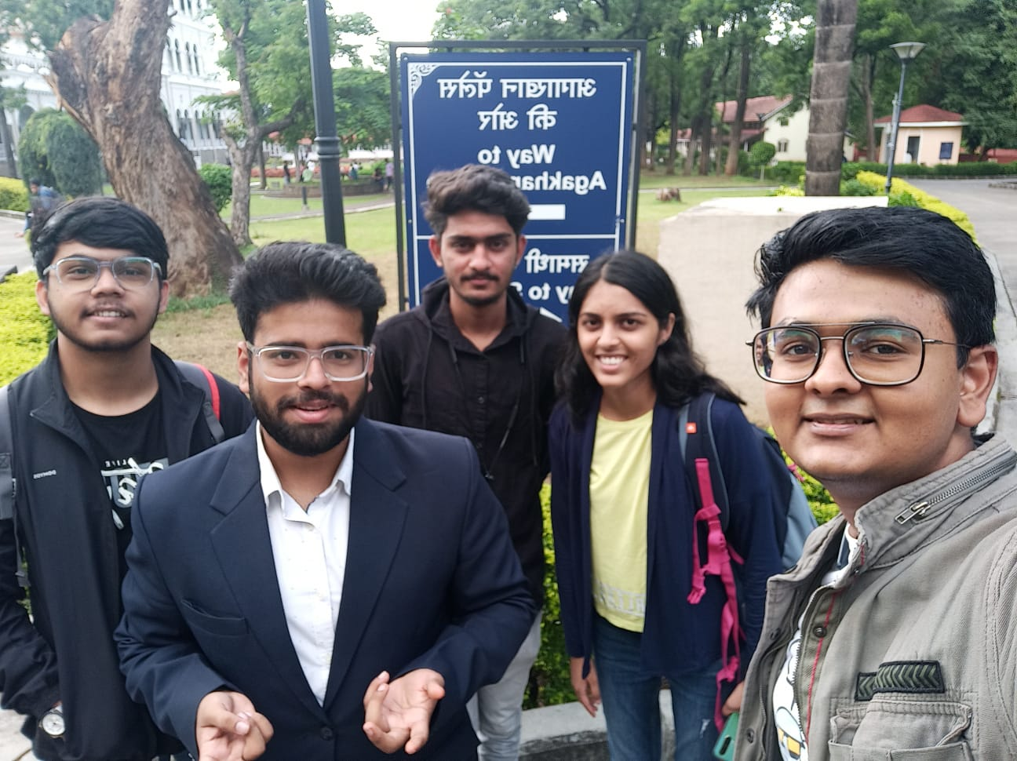
The Entrance

Slide 8
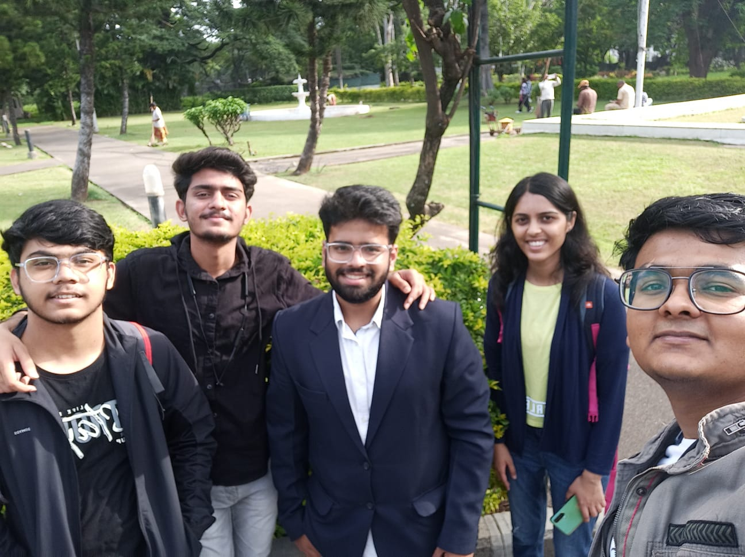

Slide 9
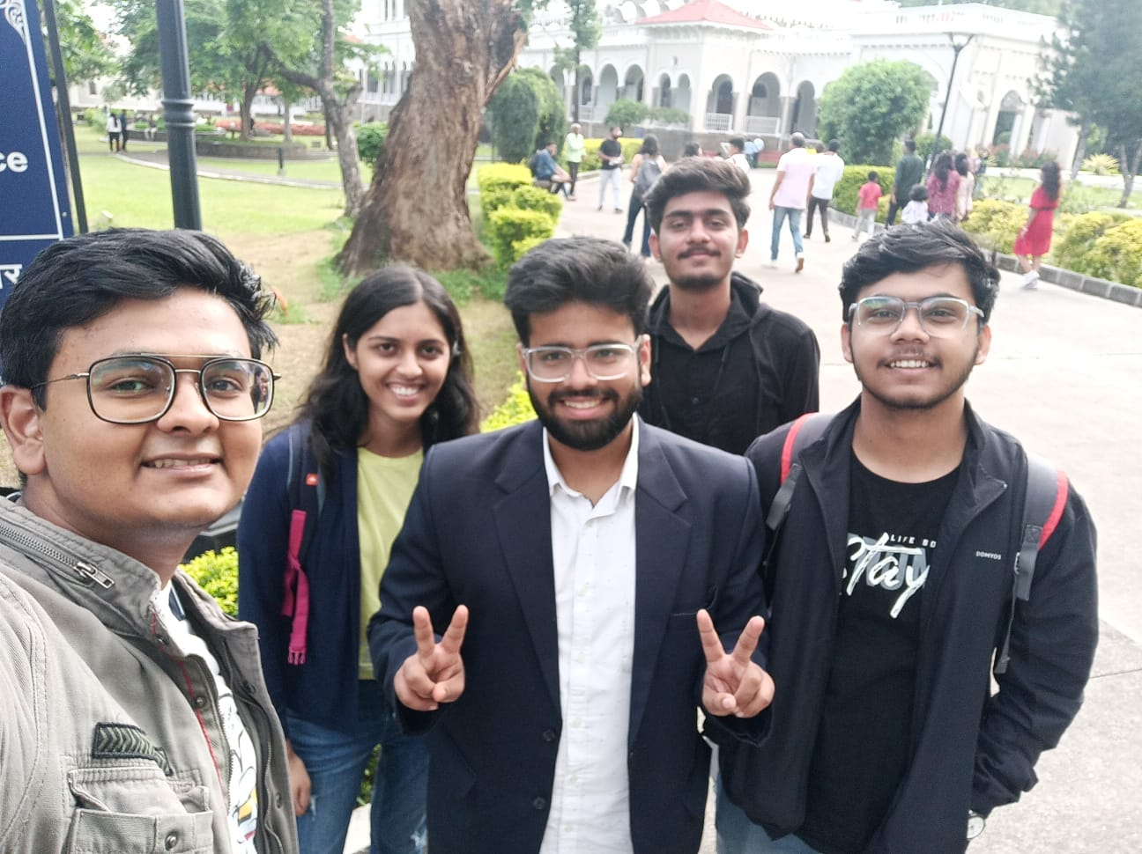

Slide 10
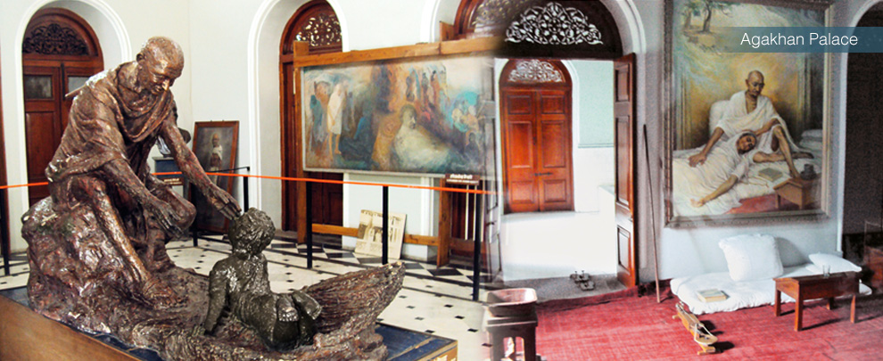
Statue of Gandhi Ji

Slide 11
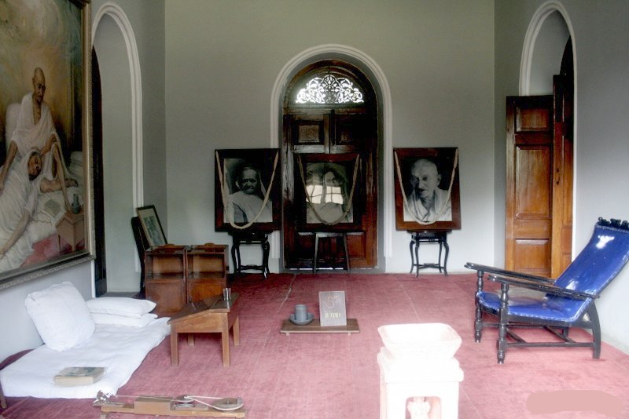
Gandhi Ji’s Room

Slide 12
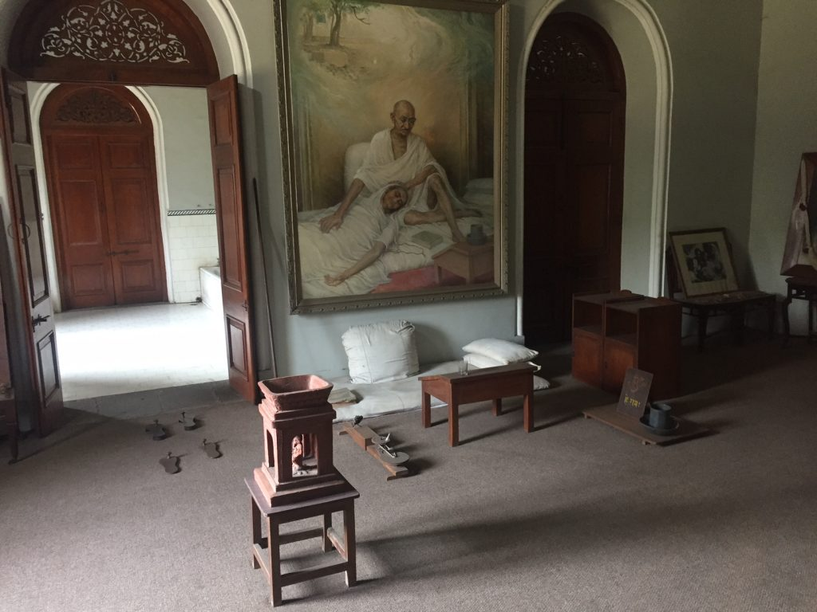
His Work Place

Slide 13
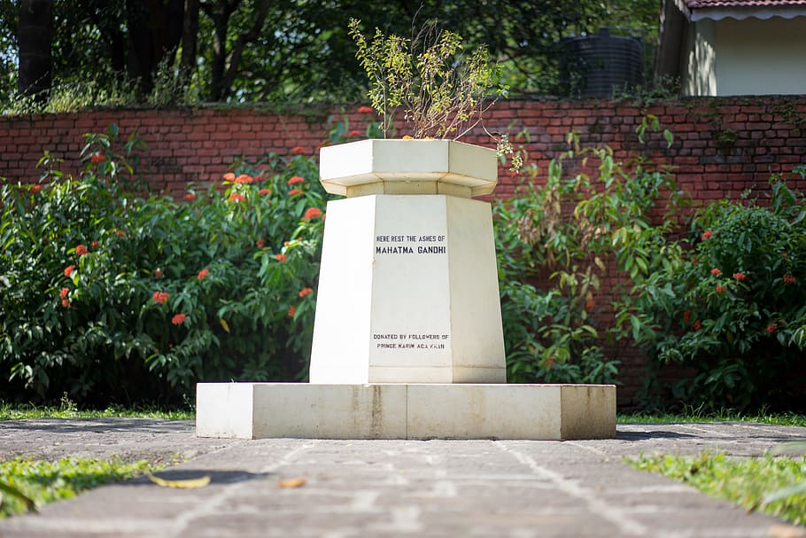
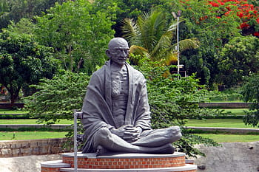
The Samadhi

Slide 14
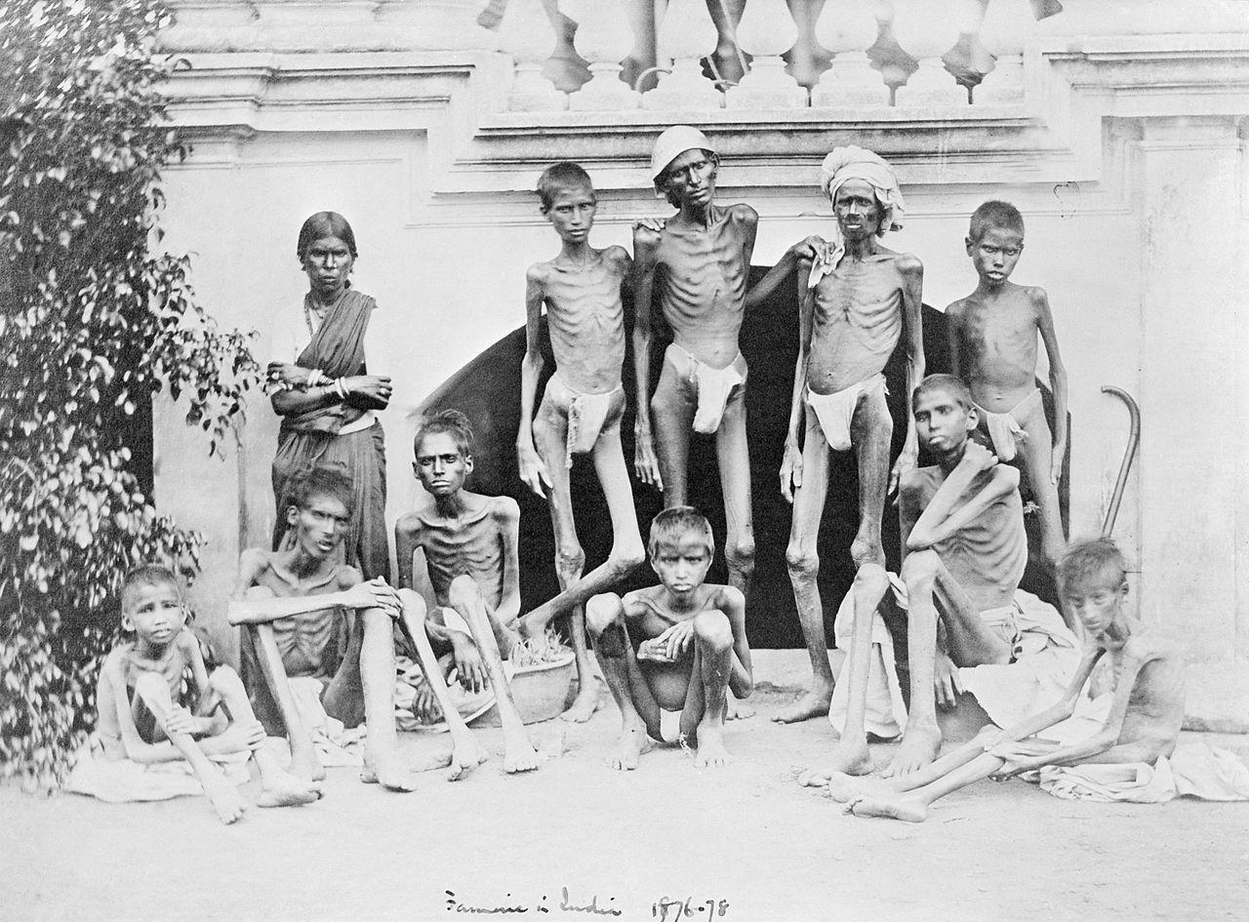
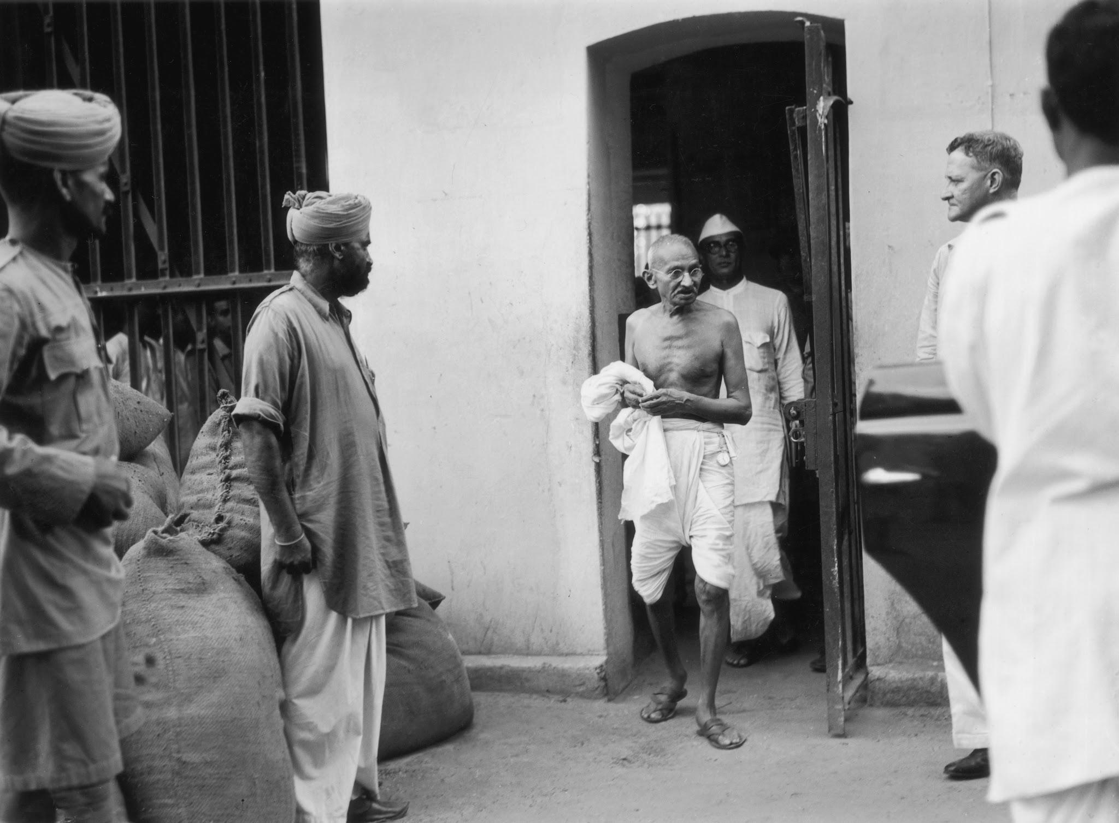
Significance of This Place
Aga Khan Palace, built in 1892, holds a significant place in India's history as a symbol of charity during times of famine and as a site of Mahatma Gandhi's imprisonment during the freedom struggle.

Slide 15
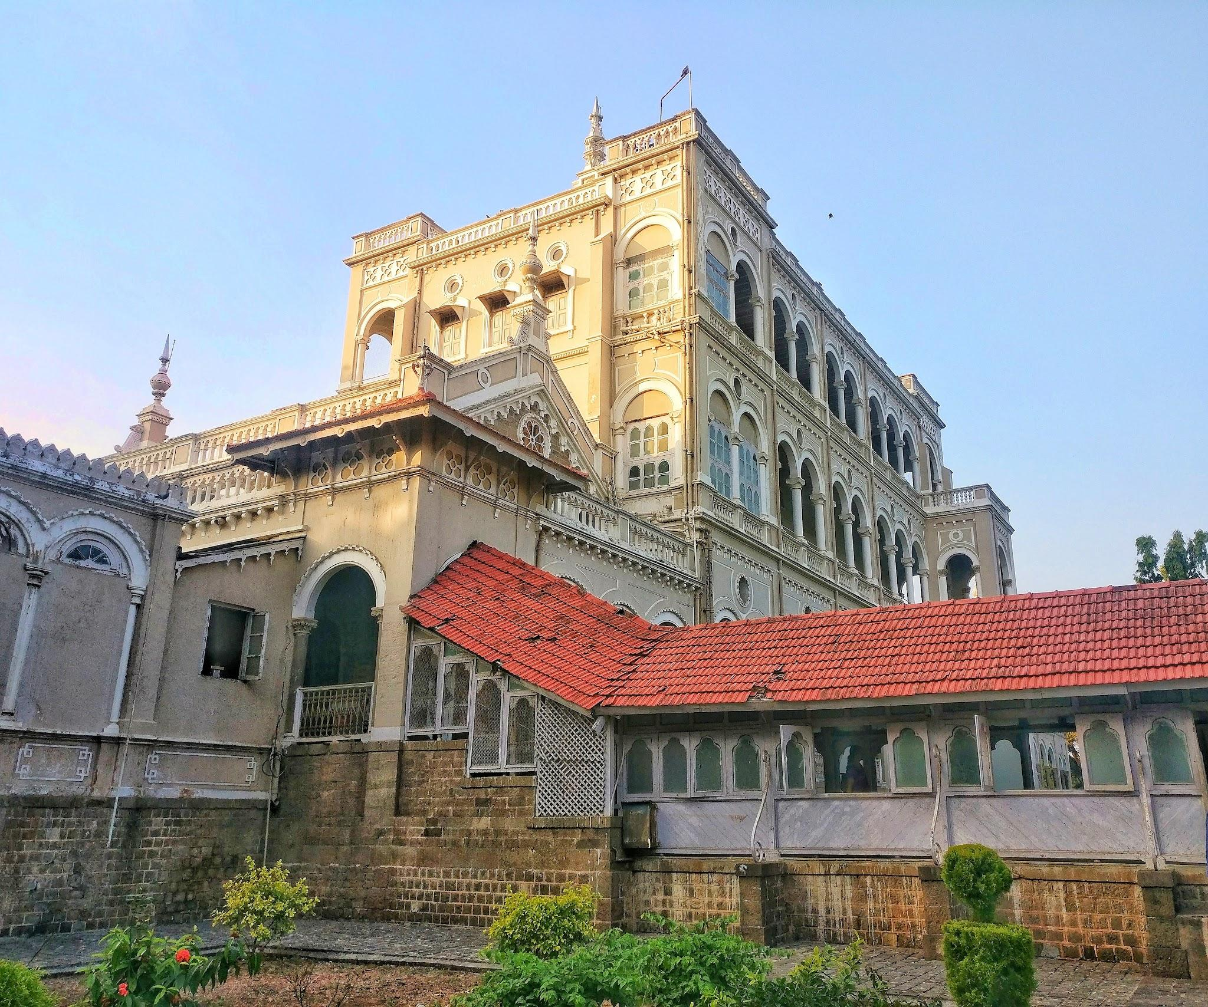
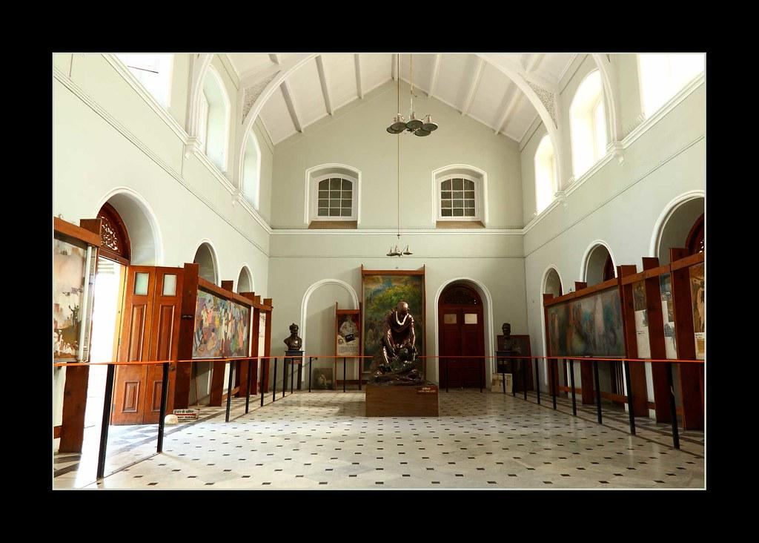
Architectural Beauty
Beyond its historical significance, the Aga Khan Palace is an architectural gem, featuring a unique blend of Islamic and Italian styles, making it not only a historical landmark but also a stunning tourist attraction.

Slide 16
Thank You!
This was a great place to visit! You should too someday!

